Slide 1
Week 3: Frontend Development with Next.js
UML cloud computing club

Slide 2
Agenda
Week 2 Recap
Git Workflow
What is Frontend Development?
Introduction to HTML, CSS, and JavaScript.
Introduction to React.js
Introduction to Next.js

Slide 3
Week 2 recap
Project Planning
Agile methodologies: Scrum and Kanban
Importance of effective planning
User stories and epics
Software Engineering Practices
Code quality and readability
Git as a version control system
Testing: Unit, Integration, End-to-End
Introduction to DevOps
Definition and significance
CI/CD pipelines
DevOps tools: Jenkins, Docker, Kubernetes
Hands-On Activity:
Fork the UniPath.io project
Setup a CI/CD pipeline with feature branches

Slide 4
Git: Basic Git Commands
git clone: Clone a repository
git add: Stage changes
git commit: Commit changes
git push: Push changes to remote
git pull: Pull changes from remote

Slide 5
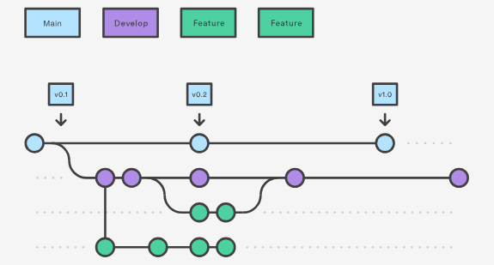
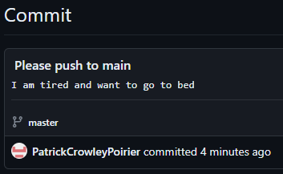
Git: Gitflow Workflow
What is Gitflow?
A branching model for Git that defines a structured workflow.
Branches Involved
main: The production-ready branch.
develop: The development branch, contains the latest delivered development changes.
feature: Branches for new features.
release: Branches for release tasks.
hotfix: Branches for quick fixes.
Workflow Steps
Develop features in feature branches.
Merge feature branches into develop.
Merge develop branches into main
How We Use Gitflow in UniPath.io
All feature development will be done in feature branches.
Code reviews before merging into develop.
Code reviews before merging into main

Slide 6

Demo: gitflow workflow for unipath.io project
Let’s walk through a gitflow workflow together
Follow “Gitflow Workflow for UniPath.io” tutorial

Slide 7
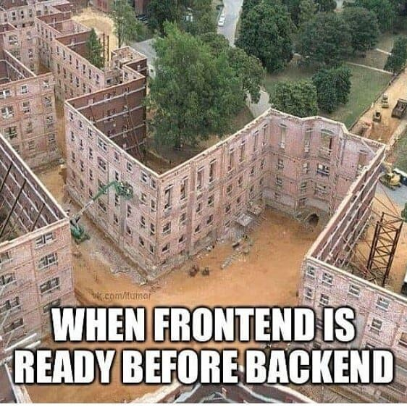
What is Frontend Development?
Definition
Frontend Development is the practice of converting data to a graphical interface for user interaction.
Core Technologies
HTML: Structure of the web pages.
CSS: Styling and layout.
JavaScript: Interactivity and dynamic content.
Responsibilities
Creating visually engaging user interfaces.
Ensuring cross-browser compatibility.
Implementing responsive design.
Role in Web Development
Works in tandem with Backend Development to create a complete web application.
Frameworks and Libraries
React, Angular, Vue.js for more complex UI/UX.

Slide 8

Demo: html, css, & Javascript
Let’s walk through the basics of HTML, CSS, & JavaScript
Follow “W3Schools: HTML, CSS, JS” tutorial

Slide 9

Introduction to React.js
What is React.js?
A JavaScript library for building user interfaces.
Who Developed It?
Developed and maintained by Facebook.
Component-Based Architecture
Build encapsulated components that manage their own state.
Virtual DOM
Optimizes rendering and improves performance.
JSX Syntax
Write HTML-like syntax within JavaScript.
Popular Use Cases
Single Page Applications (SPAs)
Mobile Applications (via React Native)

Slide 10

React JS Explained In 10 Minutes: https://www.youtube.com/watch?v=s2skans2dP4

Slide 11

Demo: Intro to React
Let’s complete the official React.js quick start and tic-tac-toe tutorial

Slide 12
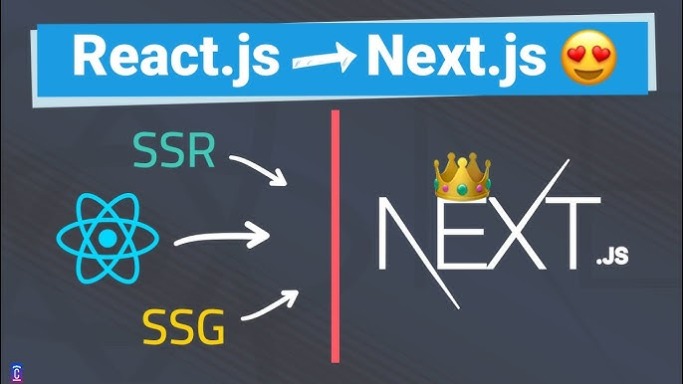
Introduction to Next.js
What is Next.js?
A React framework for server-rendered JavaScript applications.
Who Developed It?
Developed and maintained by Vercel.
Server-Side Rendering (SSR)
Enables better SEO and initial page load performance.
Static Site Generation (SSG)
Pre-renders pages at build time.
API Routes
Built-in support for API endpoints.
File-based Routing
Automatic routing based on the file structure.

Slide 13

Next.js – The Basics: https://www.youtube.com/watch?v=__mSgDEOyv8

Slide 14

Demo: Intro to next.js
Let’s generate a new Next.js project and explore how it works

